Slide 1

Smart Dustbin

Slide 2

SUPPORTING FACULTIES AND TEAM MEMBERS
DR. M. SAFA , Assistant Professor / NWC
Shaurya Singh Srinet, RA2111032010006 / NWC
Shounak Chandra, RA2111032010026 / NWC
Parth Galhotra, RA2111032010029 / NWC

Slide 3



INTRODUCTION
In an era where technology is advancing rapidly, one of the key challenges we face is effective waste management.
The Smart Dustbin project aims to tackle this challenge by integrating technology with traditional waste disposal systems.
Our project focuses on developing an innovative solution to optimize waste collection and promote a cleaner environment.

Slide 4


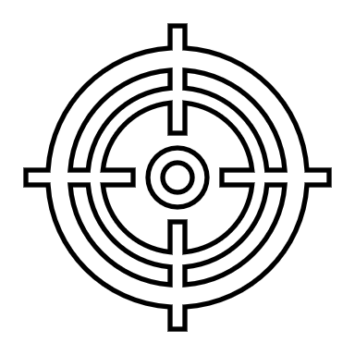
OBJECTIVE
The objective of the Smart Dustbin project is to revolutionize waste management by creating an intelligent system that automates the process of waste disposal. Utilizing Arduino, a servo motor, and an ultrasonic sensor, the project aims to develop a dustbin that opens its lid automatically when approached with garbage and closes it after disposal, promoting hands-free waste disposal and ensuring hygiene. The primary goal is to leverage technology to streamline waste collection processes, enhance cleanliness, and contribute to environmental sustainability by encouraging proper waste disposal practices.

Slide 5



METHODOLOGY
This methodology outlines the systematic approach adopted to design, develop, and implement the Smart Dustbin system, ensuring efficient waste management and promoting hygiene and cleanliness.

Slide 6
1. System Components Selection:
Identify and select appropriate components such as Arduino microcontroller, servo motor, and ultrasonic sensor based on project requirements and functionality.
2. Hardware Setup:
Connect the selected components to the Arduino board using jumper wires, ensuring proper connections and functionality.
3. Physical Assembly:
Mount the ultrasonic sensor and servo motor securely onto the dustbin, ensuring the servo motor is attached to the lid for smooth opening and closing.

Slide 7
4. Software Development:
Develop the Arduino sketch (`SmartDustbin.ino`) to control the operation of the servo motor and ultrasonic sensor, including code for lid opening upon garbage detection and automatic lid closing after disposal.
5. Testing and Debugging:
Conduct thorough testing of the hardware and software components to ensure proper functionality and reliability.
Debug any issues encountered during testing and refine the system for optimal performance.
6. Integration and Demonstration:
Integrate the hardware and software components to create a cohesive smart dustbin system.
Demonstrate the functionality of the system through real-world testing and validation, ensuring seamless operation in different scenarios.

Slide 8

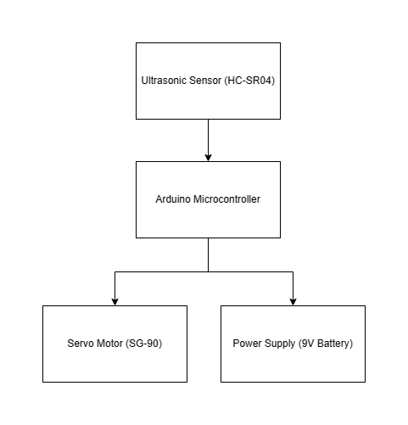
BLOCK DIAGRAM

Slide 9



SCOPE
Hardware development including component selection, integration, and physical assembly.
Software development focusing on Arduino sketch creation and implementation of lid control logic.
Comprehensive testing and validation of the system's functionality and performance.
Integration of hardware and software components for a cohesive system.
Real-world demonstration of the system's capabilities, including garbage detection and lid actuation.

Slide 10
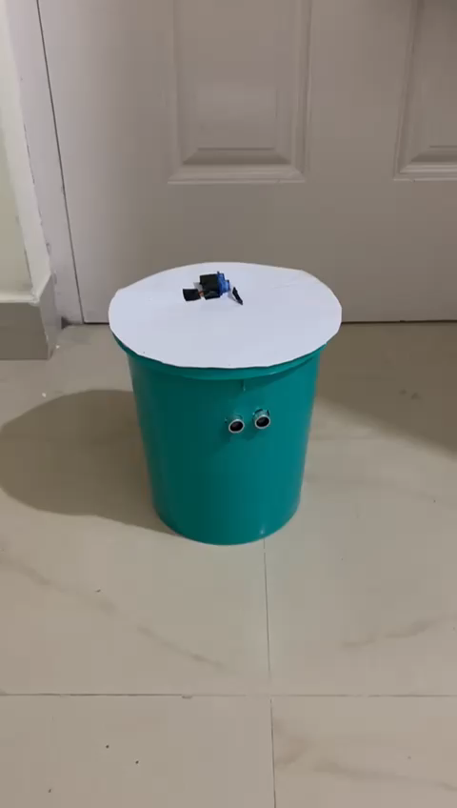
WORKING
Ultrasonic sensor detects the presence of an object (garbage) in front of the dustbin.
Arduino microcontroller processes input from the ultrasonic sensor.
Based on the sensor input, Arduino sends signals to the servo motor.
Servo motor actuates the lid of the dustbin, opening it upon garbage detection.
After disposal, the lid automatically closes, ensuring cleanliness and hygiene.

Slide 11

CONCLUSION
The Smart Dustbin project offers a promising solution for efficient waste management through automation and technology integration.
By leveraging components such as Arduino, servo motor, and ultrasonic sensor, the system provides hands-free waste disposal, promoting cleanliness and hygiene.
The successful implementation and demonstration of the Smart Dustbin highlight its potential to streamline waste collection processes and contribute to environmental sustainability.
Moving forward, further enhancements and scalability options can be explored to adapt the Smart Dustbin for various settings and applications, fostering a cleaner and more sustainable future.

Slide 12
HARDWARE COMPONENTS
1. ARDUINO UNO
2. SERVO MOTOR (SG-90)
3. ULTRASONIC SENSOR (HC-SR04)

Slide 13
THANK YOU

